Slide 1
Welcome!!
THE BLUE
ONLINE SHOP
Team Members
Filmon Abraham
Teklemariam Teweldebirhan
Robel Tesfamariam
Luwam Tesfamariam

Slide 2
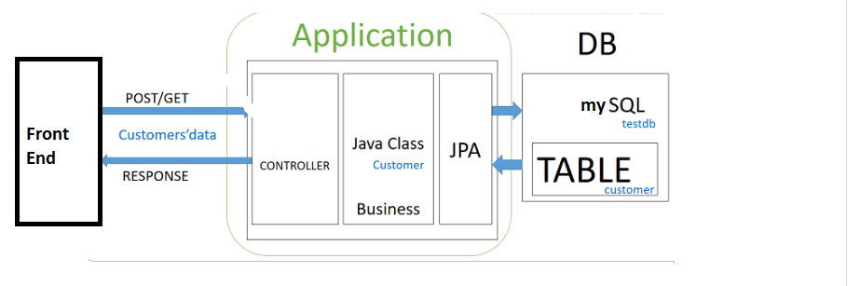
ARCHITECTURAL DESIGN

Slide 3
ARCHITECTURAL Mechanism
System Architecture – Spring Boot Project
Data base - mySql
ORM – JPA With Hibernate Implementaiton
Front End – thymeleaf view engine

Slide 4
Technologies Used
AOP
Spring Validation
Spring Security
Batching
Enterprise Integration
Restful Web Services

Slide 5
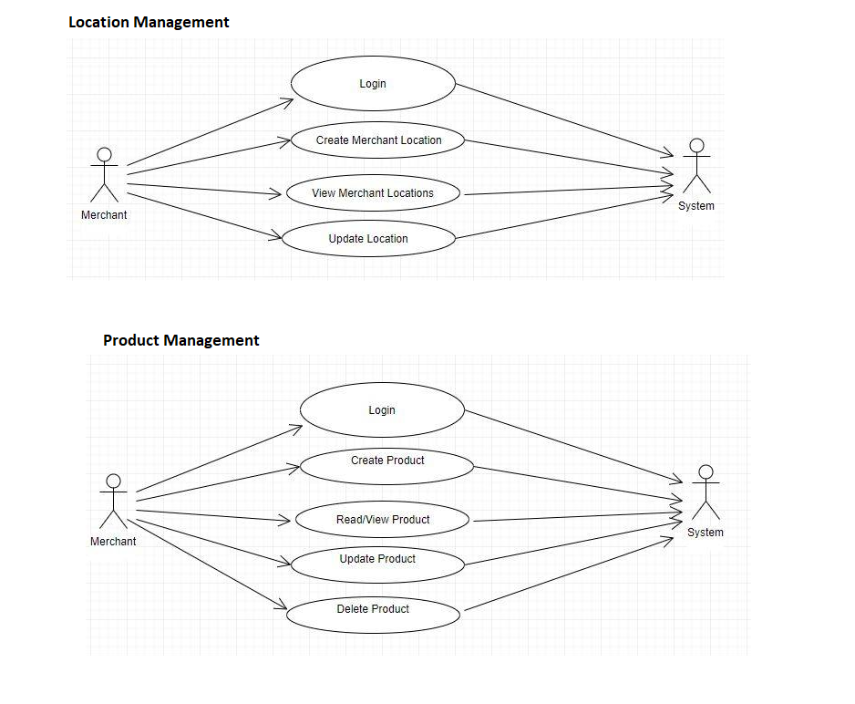
USE CASE DIAGRAMS
Location Management

Slide 6
Product Management

Slide 7
Product Management

Slide 8
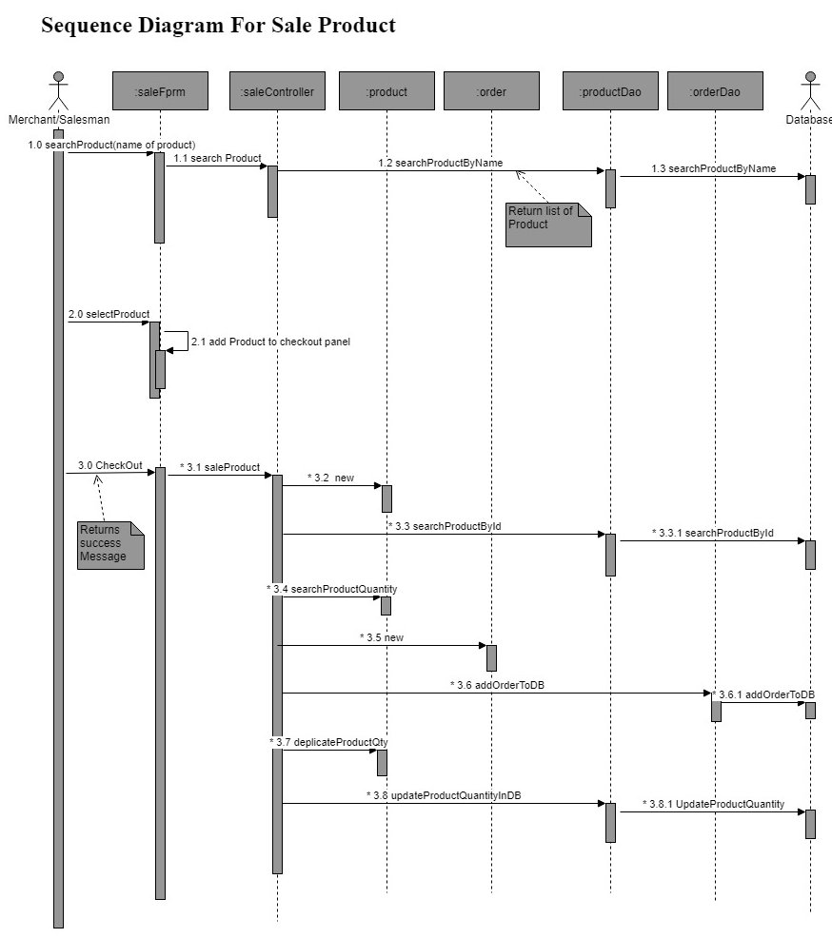
Sequence Diagram
Manage Shopping
Cart
Sign in
Process Payment
Sign out

Slide 9
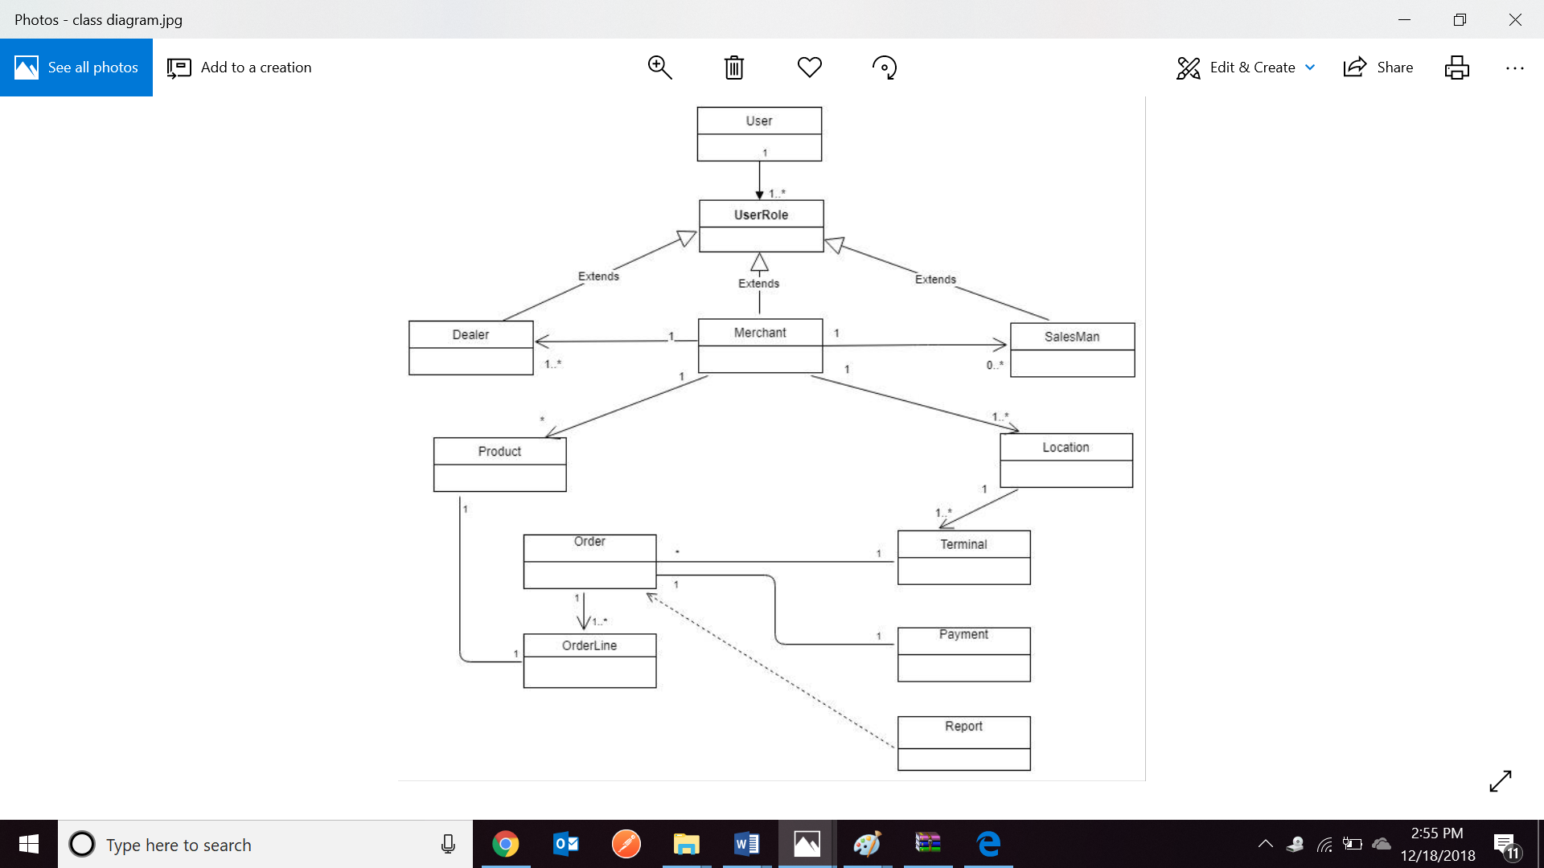
VOPC Diagram

Slide 10
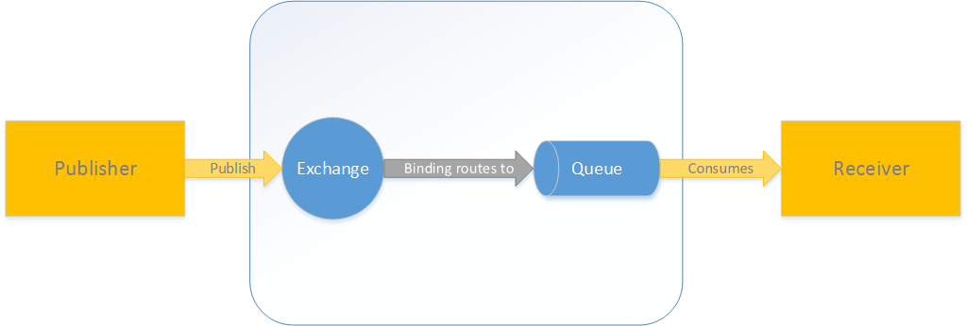
AMQP
Messaging

Slide 11
THANK YOU !!!

